Slide 1
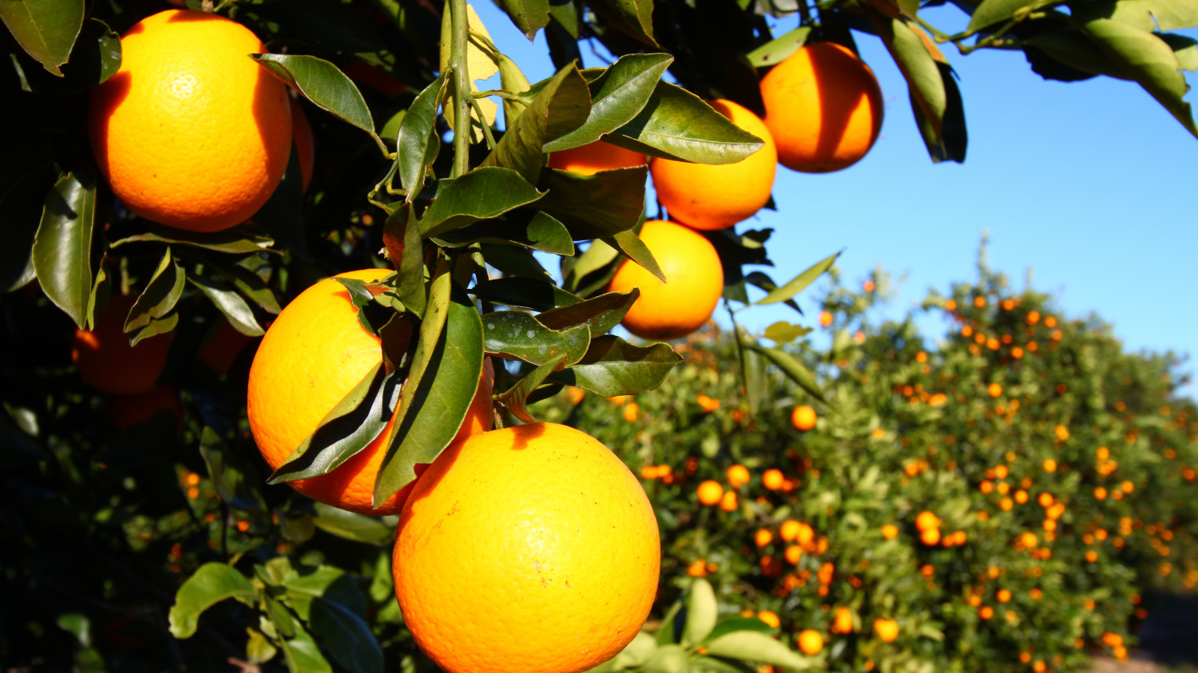
Citrus Disease
Alessandra Watkins
Candidate #7568
Center #213
(orange groves florida, 2021)

Slide 2
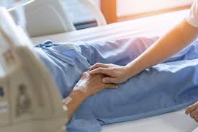
(person in hospital bed, 2021)
(disease, 2021)
(stressed person holding money, 2021)
Notes:
Don’t put the word hook

Slide 3
Problem: Citrus Disease
Huanglongbing (HLB)
Citrus Greening
Yellow Dragon
(citrus greening on oranges, 2021)

Slide 4
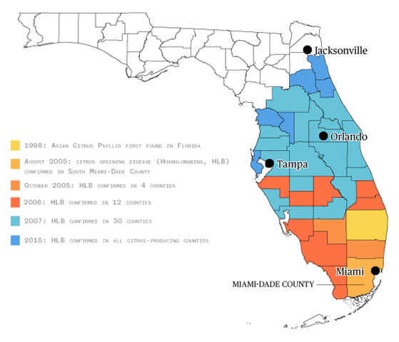
(hlb county chart in florida, 2021)

Slide 5
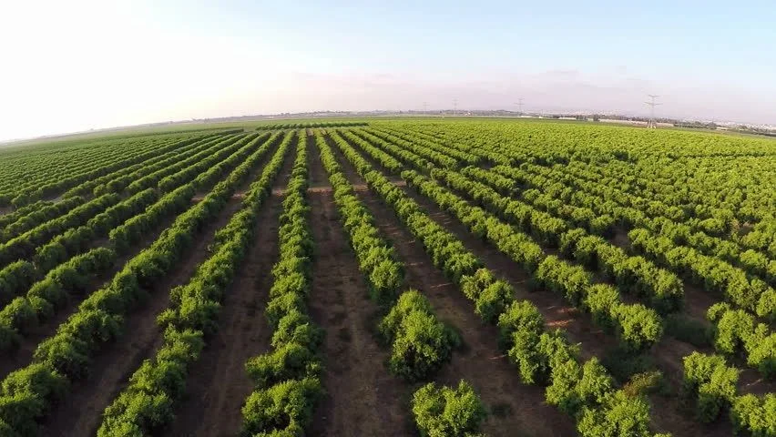
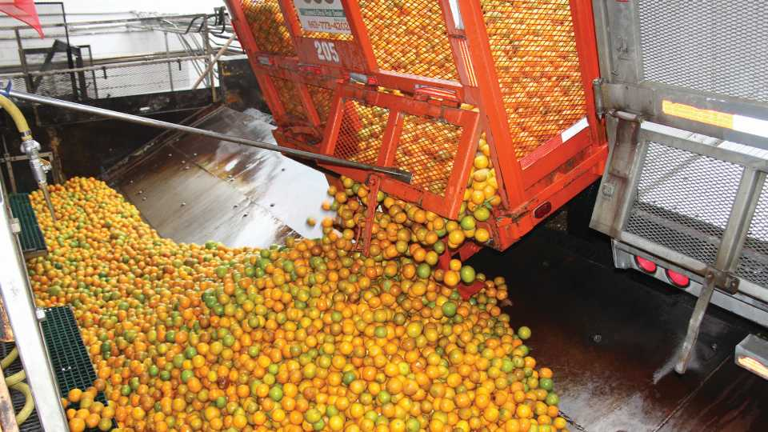
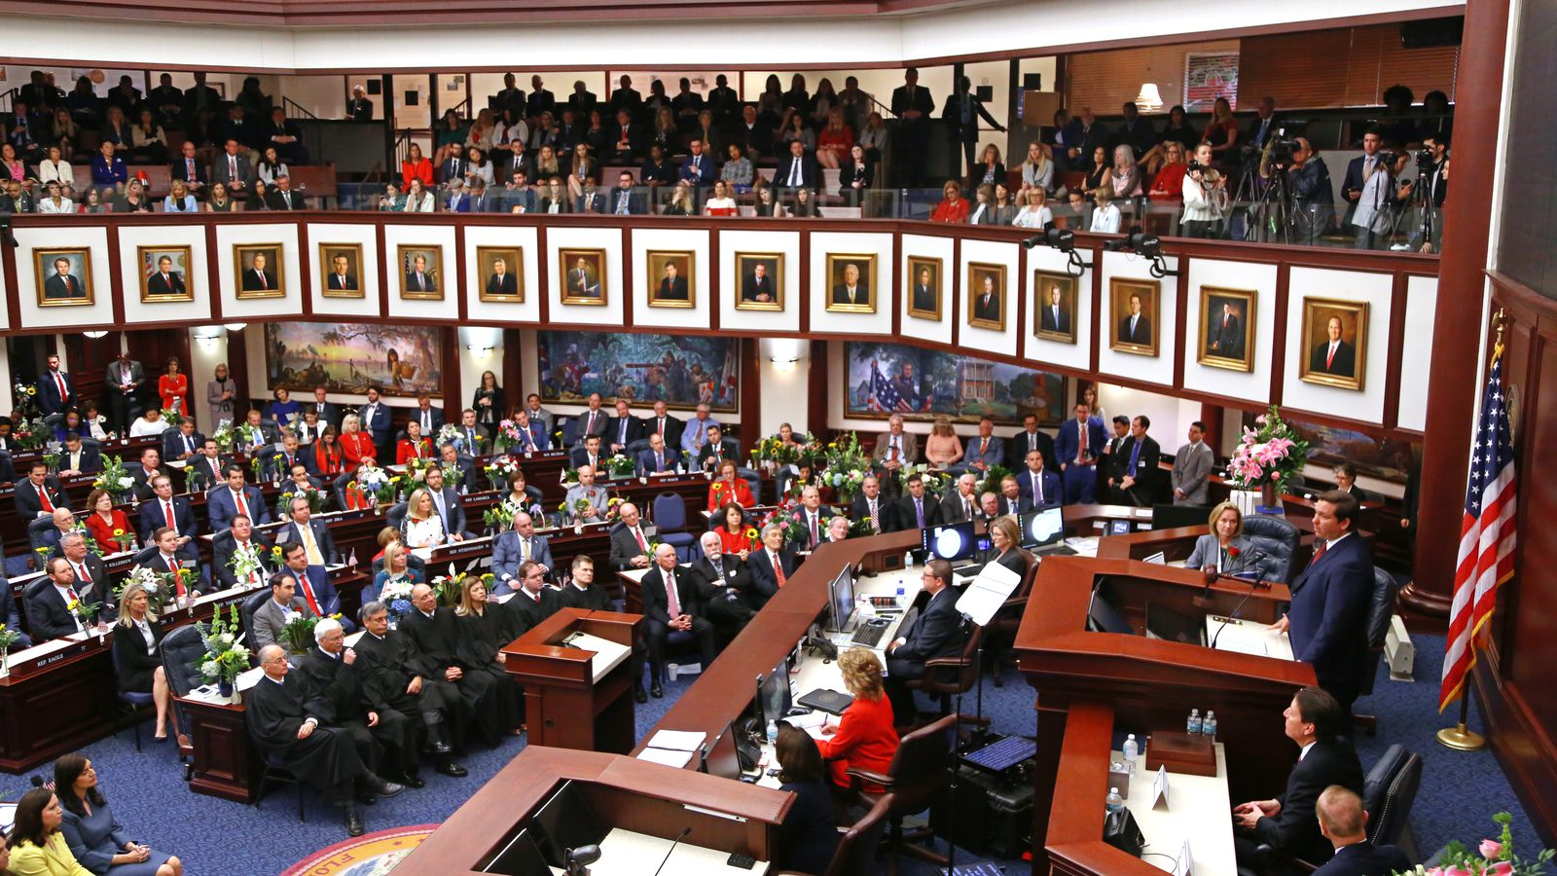
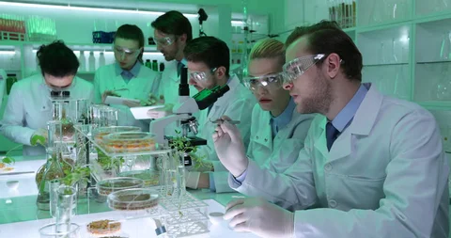
Perspectives
Environment
Scientist
Government
Economic
(orange groves aerial shot, 2021)
(orange production florida, 2021)
(scientists in lab with plants, 2021)
(florida senate in session, 2021)
Notes:
Fully define each perspective

Slide 6
Reasons
Decreases Citrus Production
Removes Jobs
Decreases Citrus Production and Revenue
Citrus Disease
(job loss, 2021)
(decreased revenue, 2021)
Removes Jobs
Notes:
Write lens on reasons slide

Slide 7
Decreases Citrus Production/Revenue (Local)
(tropicana orange truck, 2021)
Notes:
Write location on each example

Slide 8
Decreases Citrus Production/Revenue (Global)
(map of kenya, 2021)

Slide 9
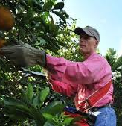
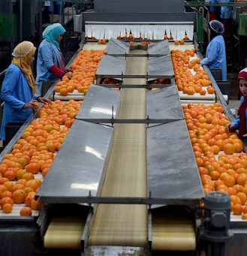
Removes Jobs (Local)
(citrus growers, 2021)
(citrus processing plant with workers, 2021)
(orange packing houses, 2021)

Slide 10
Removes Jobs (Local)
(florida citrus growers, 2021)

Slide 11
Recap
Citrus Disease...
Decreases Citrus Production and Revenue
Removes Jobs
(decreased revenue, 2021)
(job loss, 2021)
Notes:
Put lens on recap slide

Slide 12
Potential Solutions
Replace Oranges with Pongamia
Have Companies and Farmers Cooperate

Slide 13
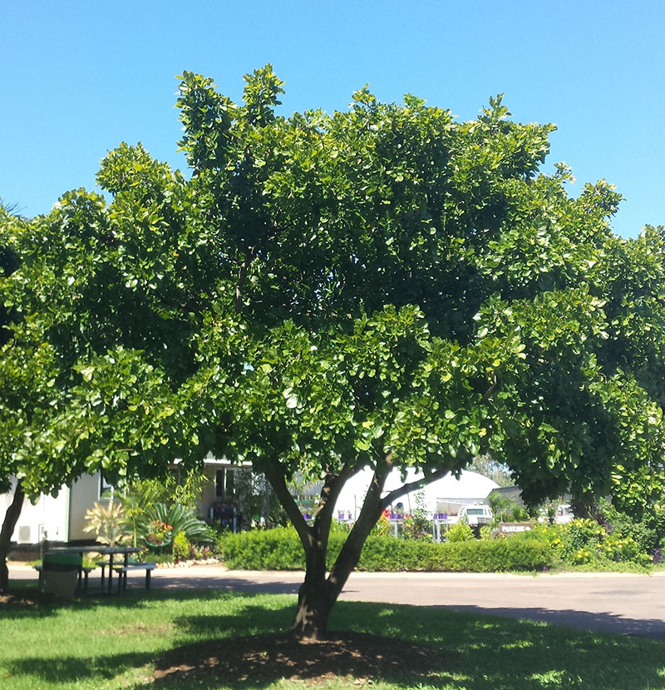
Solution 1- Pongamia (Local)
(pongamia tree, 2021)
(pongamia tree, 2021)

Slide 14
Solution 1- Pongamia (Local)
(pongamia based products, 2021)

Slide 15
Solution 2- Cooperation (Global)
(map of brazil, 2021)

Slide 16
Solution 2- Cooperation (Global)
(farmer and businessman cooperating, 2021)

Slide 17
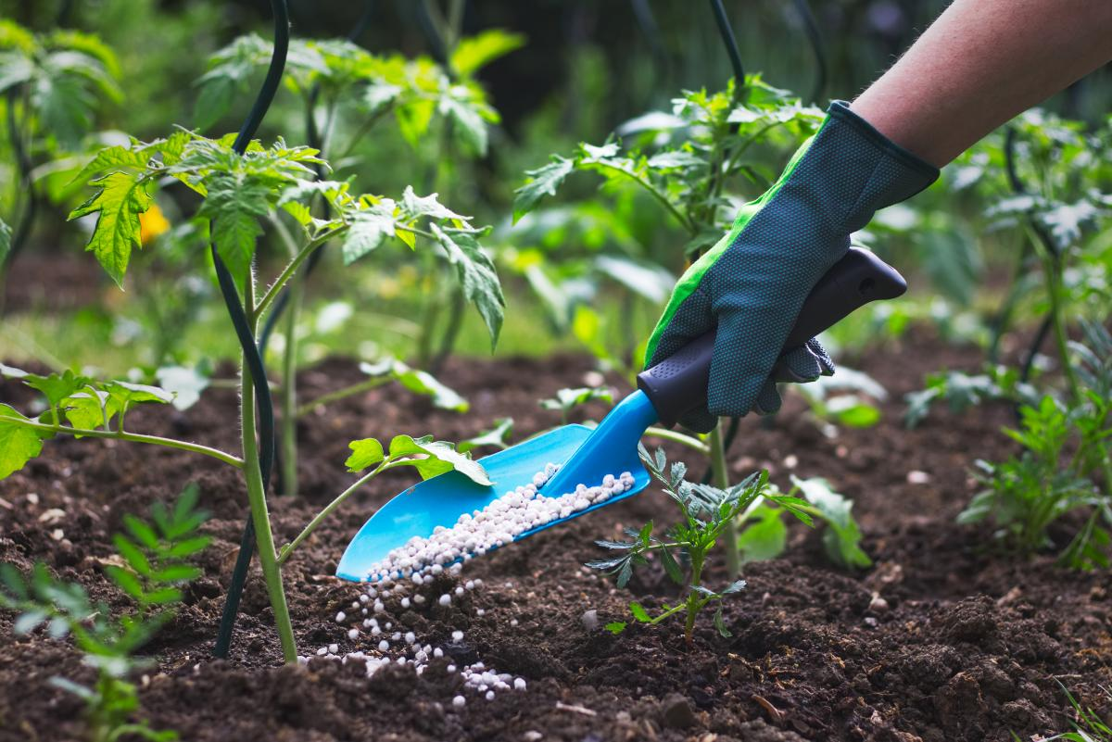
Innovation
(teens growing plants in greenhouse, 2021)
(person giving plants to farmer, 2021)

Slide 18
Innovation
(map of florida counties, 2021)

Slide 19
Recap
Have Companies and Farmers Cooperate
Solutions
Replace Oranges with Pongamia
Problems
Decreases Citrus Production
Removes Jobs

Slide 20
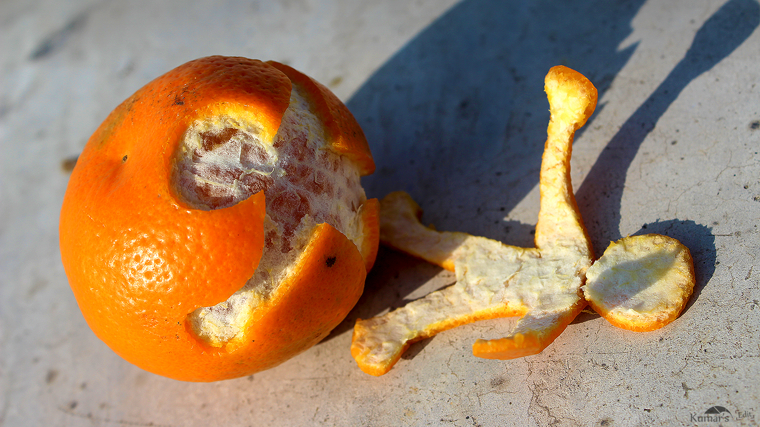
(people oranges, 2021)

Slide 21
References
Court et al. (2017). Economic Contributions of the Florida Citrus Industry in 2015-16. UF IFAS. https://fred.ifas.ufl.edu/pdf/economic-impact-analysis/Economic_Impacts_of_the_Florida_Citrus_Industry_2015_16.pdf
Singerman & Rogers. (2020). The Economic Challenges of Dealing with Citrus Greening: The Case of Florida. OUP Academic. https://academic.oup.com/jipm/article/11/1/3/5700462
Singerman & Useche. (2016). Impact of Citrus Greening on Citrus Operations in Florida. University of Florida. https://crec.ifas.ufl.edu/extension/citrus_rootstock/rootstock-literature/2016.%20A.%20Singerman,%20P.%20Useche,%20Impact%20of%20Citrus%20Greening%20on%20Citrus%20Operations%20in%20Florida%20(REPORT).pdf
Wangithi. (2019). ECONOMIC IMPACT ASSESSMENT OF INTEGRATED CITRUS PESTS AND DISEASES MANAGEMENT INTERVENTIONS IN SELECTED COUNTIES, KENYA. Egerton University. http://34.250.91.188:8080/xmlui/bitstream/handle/123456789/996/Charity%20MscTHESIS%20March_2019%20.pdf?sequence=1&isAllowed=y
Citrus Greening. (2021). USDA Animal and Plant Health Inspection Service. https://www.aphis.usda.gov/aphis/resources/pests-diseases/hungry-pests/the-threat/citrus-greening/citrus-greening-hp
CAREGIVER HOLDING ELDERLY SENIOR PATIENT (AGEING OLD ADULT PERSON) HAND IN HOSPITAL BED OR NURSING HOSPICE, GERIATRICIAN PALLIATIVE HOME, WHILE CARETAKER HAVING MEDICAL HEALTH CARE SERVICE. (2020). [Photograph]. https://images.app.goo.gl/UtHc9tHrpFQY5ERh8
Infectious diseases. (2021). [Image]. https://images.app.goo.gl/JeGppaUPtt62Xn5S8
Coping with Financial Stress. (2020). [Photograph]. https://images.app.goo.gl/DVFhtUPp8A6Csgzh6
USA APHIS. (2021). [Photograph]. https://images.app.goo.gl/FL9cbQm2bWcfXbro8
One-two punch of disease and Irma has left Florida citrus reeling. (2018). [Chart]. https://images.app.goo.gl/atgT5bQ6HgcE8qtE8
Arizona citrus farmers being squeezed out by development, costs. (2019). [Photograph]. https://images.app.goo.gl/fVLPwPnLrTPJMCwj6
Visit A Citrus Grove. (2021). [Photograph]. https://images.app.goo.gl/3vgBDkLQkXb8sB8ZA
Aerial Shot of Orange Groves. (2021). [Photograph]. https://images.app.goo.gl/cg7Bk5Xc83mFcwoJ8
Scientists Group Study Seedlings Plant Stock Footage Video. (2021). [Photograph]. https://images.app.goo.gl/g7Bsc3hYBDbPVCNg8
Florida Senate committee to take up Amendment 4 debate today. (2019). [Photograph]. https://images.app.goo.gl/xHrzw4J71GqHHvUCA

Slide 22
References
Visit A Citrus Grove. (2021). [Photograph]. https://images.app.goo.gl/3vgBDkLQkXb8sB8ZA
Greyhound revenue dips but profits rise 2.7 percent. (2017). [Image]. https://images.app.goo.gl/bC4foUkLQEtVmaAp8
News: COVID-19: 65% of Americans worried about job loss. (2021). [Image]. https://images.app.goo.gl/UWaM2P55S5FjMmkf9
25 Jul Profitable Pongamia: High value biofuel from an Australian native. (2021). [Photograph]. https://lucasgroup.com.au/profitable-pongamia-high-value-biofuel-from-an-australian-native/
Millettia pinnata (Pongamia/Indian Beech). (2021). [Photograph]. https://www.territorynativeplants.com.au/millettia-pinnata-pongamiaindian-beech
The Pongamia Prospect. (2021). [Photograph]. https://www.tcbusiness.com/agriculture/the-pongamia-prospect/
BRAZIL PHYSICAL MAP. (2021). [Photograph]. https://www.freeworldmaps.net/southamerica/brazil/map.html
Farmer and businessman shaking hands at the cornfield. (2021). [Photograph]. https://www.westend61.de/en/imageView/ABIF00949/farmer-and-businessman-shaking-hands-at-the-cornfield
Students plant seeds of leadership, grow a community. (2021). [Photograph]. https://www.atholdailynews.com/Planting-seeds-in-Orange-with-photos-18437003
HOW TO FERTILIZE YOUR VEGETABLE GARDEN HOW AND WHEN DO YOU FERTILIZE YOUR GARDEN PLANTS? (2021). [Photograph]. https://www.almanac.com/how-fertilize-your-vegetable-garden
Florida Counties Blank Outline Map Poster. (2021). [Photograph]. https://www.zazzle.com/florida_counties_blank_outline_map_poster-228276308996696800
HLB in Brazil: What’s working and what Florida can use. (2016). IFAS. https://crec.ifas.ufl.edu/media/crecifasufledu/extension/extension-publications/2016/2016_June_brazil.pdf
Managing Citrus Greening - UF/IFAS Extension: Solutions for Your Life. (2017). UF IFAS Extension. https://sfyl.ifas.ufl.edu/archive/hot_topics/agriculture/citrus_greening_management.shtml
Eating Oranges in the Shower Is the Self-Care You Didn’t Know You Needed. (2021). [Photograph]. https://www.vice.com/en/article/qkngzv/eating-oranges-in-the-shower-is-the-self-care-you-didnt-know-you-needed

Slide 23
References
What is the State of Citrus in Florida? Here Are the Survey Results. (2019). [Photograph]. https://images.app.goo.gl/4aamSDab5NY8kRGp9
Packing-houses. (2019). [Photograph]. https://images.app.goo.gl/PmLfbCQZPgBqn43s8
Hurricane Irma’s impact: Florida citrus growers project 35% crop less. (2017). [Photograph]. https://images.app.goo.gl/BeFbxgF1bULj8RdP9
Feature: Citrus farms prosper in Egypt as country becomes 3rd largest orange exporter to China - Zinhua. (2018). [Photograph]. https://images.app.goo.gl/KFZupKvNx2Si7btn8
Vern Buchanan says aid for citrus growers will be part of new hurricane relief bill. (2017). [Photograph]. https://images.app.goo.gl/kUY1MtXXz3Y19d5i9
Map:Kenya. (2021). [Map]. https://images.app.goo.gl/qyFsVdUCzuUr92Cw9
TROPICANA015.jpg. (2009). [Photograph]. https://images.app.goo.gl/uL7dHsD4ME6g5Dgs7
Greyhound revenue dips but profits rise 2.7 percent. (2017). [Image]. https://images.app.goo.gl/bC4foUkLQEtVmaAp8
News: COVID-19: 65% of Americans worried about job loss. (2021). [Image]. https://images.app.goo.gl/UWaM2P55S5FjMmkf9
Scientists Group Study Seedlings Plant Stock Footage Video. (2021). [Photograph]. https://images.app.goo.gl/g7Bsc3hYBDbPVCNg8
Florida Senate committee to take up Amendment 4 debate today. (2019). [Photograph]. https://images.app.goo.gl/xHrzw4J71GqHHvUCA

